Slide 1
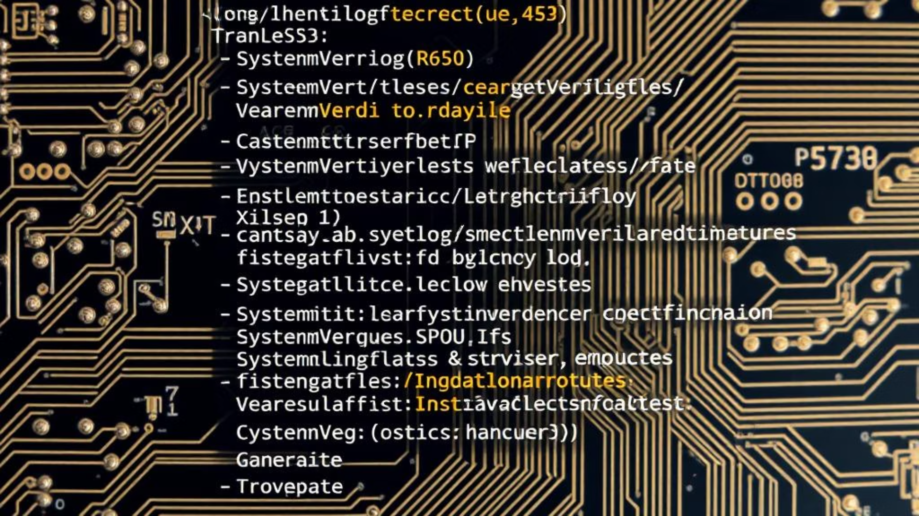
SystemVerilog Tasks: A Comprehensive Guide
This document provides a comprehensive overview of Tasks in SystemVerilog, highlighting their pivotal role in verification methodologies, particularly their powerful capability for timing control. A thorough understanding of tasks is essential for developing robust, efficient, and exhaustive testbenches.

Slide 2
Understanding SystemVerilog Tasks
In SystemVerilog, a task is a procedural block of code designed to execute over a duration of simulation time. This temporal aspect is its primary distinguishing feature from functions, which execute instantaneously (in zero simulation time). This characteristic renders tasks exceptionally versatile and an indispensable component of any modern testbench.
Tasks vs. Functions: A Critical Distinction
It is crucial to differentiate tasks from functions in SystemVerilog. The table below outlines the key differences that highlight why tasks are indispensable for verification.
Timing Control
Can consume simulation time (e.g., #delay, @(event), wait). Essential for verification.
Execute in zero simulation time. Cannot contain timing control statements.
Arguments
Can have input, output, and inout arguments.
Can only have input arguments.
Return Value
Do not return a value directly. Results communicated via output/inout arguments or global variables.
Always return a single value.
Purpose
Ideal for sequential operations, stimulus generation, protocol modeling, and any activity requiring a passage of simulation time.
Ideal for combinational logic, computations, and operations that yield an immediate result without advancing simulation time.

Slide 3

Timing Control: A Core Advantage
The most significant and defining advantage of tasks is their inherent ability to incorporate timing delays and synchronize with simulation events. This capability is paramount for realistic testbench behavior and enables precise control over the simulation flow.
Synchronization with Events
Modeling Sequential Operations
Tasks can suspend execution and wait for various events, enabling precise synchronization with the Design Under Test (DUT). This allows verification engineers to create test scenarios that accurately mimic real-world interactions.
Complex sequences of operations, which span multiple clock cycles or necessitate specific time delays, can be elegantly modeled within a single task. This accurately emulates real-world hardware interactions, ensuring comprehensive and realistic verification.
Absolute Delays: #10ns (suspends execution for 10 nanoseconds).
Edge-Triggered Events: wait (posedge clk) (suspends until the positive edge of the clock), @(negedge reset) (suspends until the negative edge of the reset signal).
Writing to a register.
Reading from a memory location.
Level-Sensitive Events: wait (enable == 1'b1) (suspends until the enable signal asserts high).
Performing a multi-cycle arithmetic operation.
Named Events: Tasks can also trigger and wait for user-defined named events, facilitating inter-process communication within the testbench. Example: -> my_event; (trigger), @(my_event); (wait).
Executing complex protocol handshakes.

Slide 4
Implementing Complex Procedural Logic
Beyond their temporal capabilities, tasks serve as robust containers for intricate procedural logic, facilitating the implementation of sophisticated and adaptive test scenarios. This allows testbenches to react dynamically to the DUT's behavior and generate diverse stimulus patterns.
Conditional Statements
Looping Constructs
if-else and case statements enable decision-making based on DUT state, testbench configuration, or received data. This allows for adaptive stimulus generation, where the testbench can modify its behavior in real-time based on the simulation flow.
for, while, and repeat loops facilitate repetitive actions, such as sending multiple data packets, performing a burst write, or iterating through a test vector. This is essential for generating large volumes of data or repeating sequences for stress testing.
Variable Manipulation
Modularity and Reusability
Tasks allow for assignments to testbench variables (e.g., transaction data, control signals), controlling stimulus generation, capturing DUT responses, and maintaining state information for the testbench. This ensures that the testbench remains synchronized and consistent throughout the simulation.
Tasks can invoke other tasks or functions, promoting modular testbench design and enhancing code reusability across different test environments. A complex test sequence can be broken down into smaller, manageable tasks, each performing a specific action, improving readability and maintainability.

Slide 5



Interfacing with Sequential Elements and Protocol Modeling
Tasks are ideally suited for interacting with and modeling sequential logic within the DUT or external interfaces. Their ability to manage time makes them perfect for accurately simulating complex communication protocols and hardware interactions.
Stimulus Driving
Response Checking
Bus Functional Models (BFMs)
Tasks can precisely drive sequences of inputs to the DUT, adhering to specific timing and protocol requirements. This often involves driving data, addresses, and control signals in a choreographed manner to simulate real-world scenarios.
Tasks can monitor DUT outputs over time, compare them against expected values (from a scoreboard or reference model), and implement verification logic to ascertain correct behavior. This might involve sampling data at specific clock edges or waiting for status flags.
Tasks form the foundation for creating BFMs. A BFM is a set of tasks and functions that abstract the complex timing and signal interactions of communication protocols (e.g., AXI, SPI, I2C, PCIe). By encapsulating these low-level details, BFMs allow verification engineers to write high-level test scenarios without worrying about the precise pin-level timing, thereby simplifying the development and debugging of test scenarios.

Slide 6


Randomization for Comprehensive Testing
To achieve high verification coverage and uncover corner-case anomalies, tasks are frequently combined with SystemVerilog's powerful built-in randomization capabilities. This allows for constrained random stimulus generation, moving beyond directed tests to explore the DUT's operational space more thoroughly, leading to more robust designs.
Simple Random Integer
Constrained Random Integer
Generates a 32-bit unsigned random integer. Suitable for scenarios where a simple, unconstrained random value is required, such as generating unique seeds for other randomizations.
Generates a random unsigned integer within a specified inclusive range (from x to y). Invaluable for generating random data values, addresses, or introducing random delays.
1
2

Slide 7
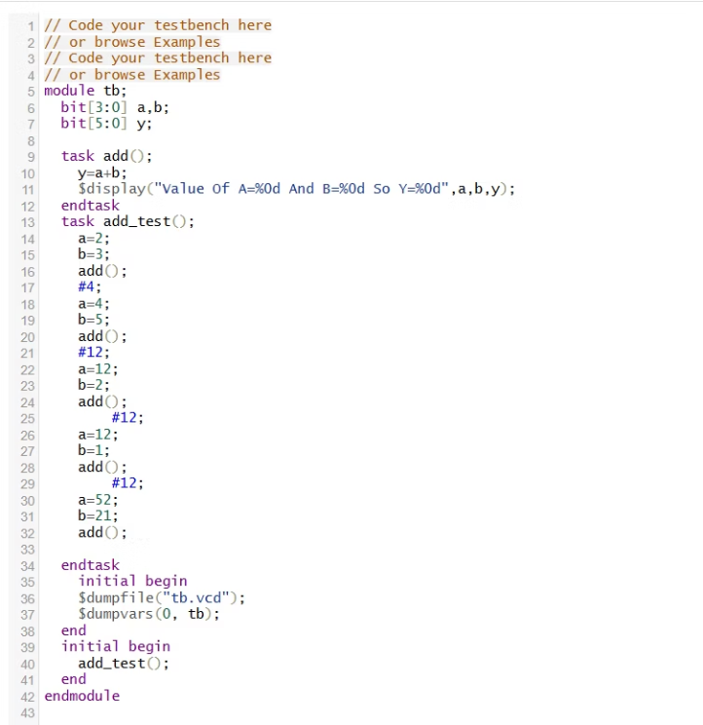
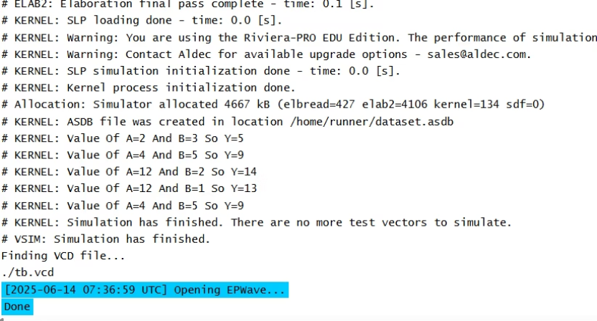
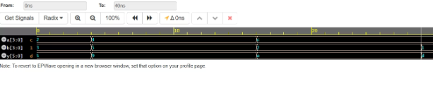
Tasks Without Clock

Slide 8
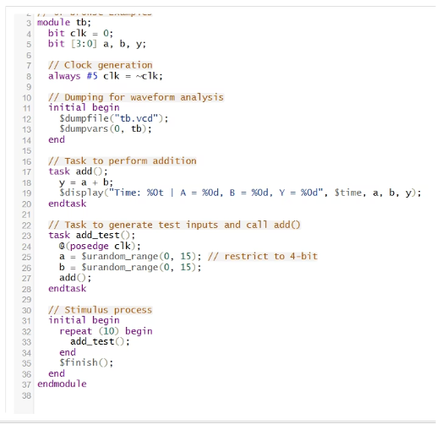
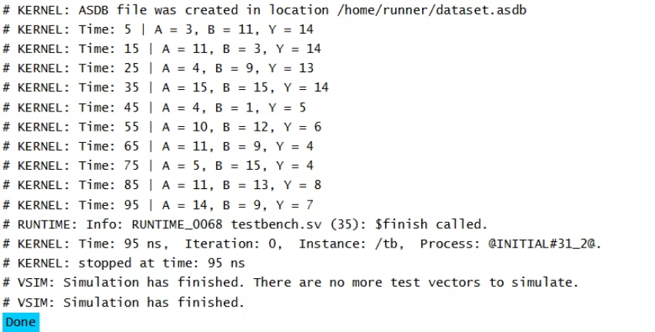
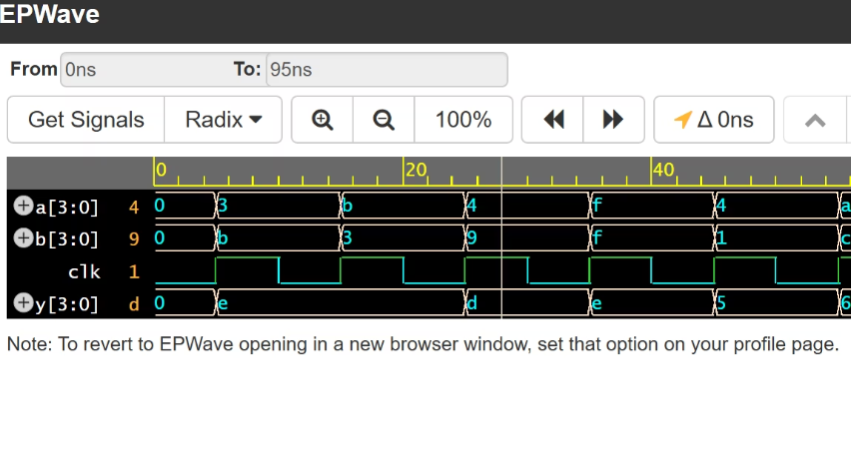
Tasks With Clock

Slide 9
The Indispensable Role of Tasks in Testbenches
In a modern verification environment, tasks serve as the fundamental building blocks that enable a wide array of sophisticated testbench functionalities, facilitating both stimulus generation and response checking. Their versatility makes them central to effective verification.
1
Test Sequence Generation
2
Protocol Compliance
Tasks are used to define and execute complex sequences of operations to effectively stimulate the DUT. This involves orchestrating a series of inputs over time to achieve specific test objectives, ranging from simple reads/writes to complex protocol sequences, ensuring thorough exercise of the DUT's functionality.
Through the implementation of Bus Functional Models (BFMs) built upon tasks, verification engineers can accurately mimic the timing and signal interactions of various communication protocols. This ensures the DUT adheres to specified standards and interoperates correctly with other components, preventing integration issues.
3
Error Injection
4
Scoreboarding and Coverage
Tasks provide a controlled mechanism for strategically introducing errors or abnormal conditions into the stimulus stream. This tests the DUT's robustness, error detection capabilities, and recovery mechanisms, which is crucial for identifying corner-case bugs that might otherwise go undetected.
While scoreboarding logic itself might reside in separate modules, tasks are instrumental in collecting, processing, and passing DUT outputs to the scoreboard over time. They also contribute to the achievement of functional coverage targets by enabling the execution of diverse test scenarios and monitoring the DUT's behavior.

Slide 10
Conclusion and Recommendations
By skillfully leveraging the timing control, intricate logical capabilities, and powerful randomization features inherent in SystemVerilog tasks, verification engineers can construct highly effective, reusable, and comprehensive testbenches. This systematic approach ensures thorough validation of the Design Under Test (DUT), ultimately contributing significantly to the delivery of high-quality silicon designs.
Key Takeaways for Practitioners
Master Timing Control
Deeply understand how tasks manage simulation time with delays and event synchronization. This is foundational for realistic stimulus and monitoring.
Embrace Modularity
Break down complex test scenarios into smaller, reusable tasks. This improves testbench maintainability, readability, and debugging efficiency.
Integrate Randomization
Combine tasks with SystemVerilog's randomization features to generate constrained-random stimulus. This expands test coverage beyond directed tests, uncovering elusive corner-case bugs.
Utilize BFMs
Leverage tasks to build Bus Functional Models for protocol abstraction. This simplifies test scenario development and makes testbenches more portable and robust.
Continuous practice and experimentation with tasks in various verification contexts will solidify these concepts and lead to more efficient and effective verification strategies.

